Slide 1
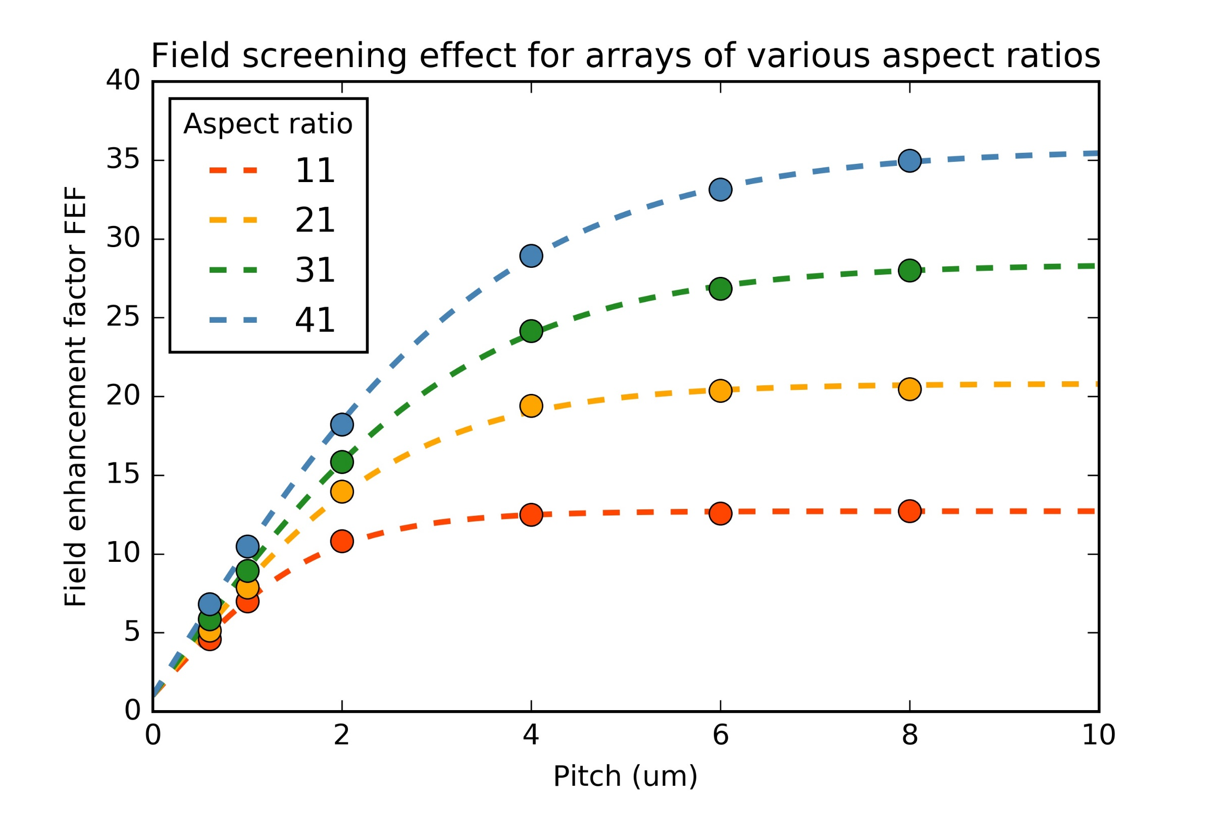
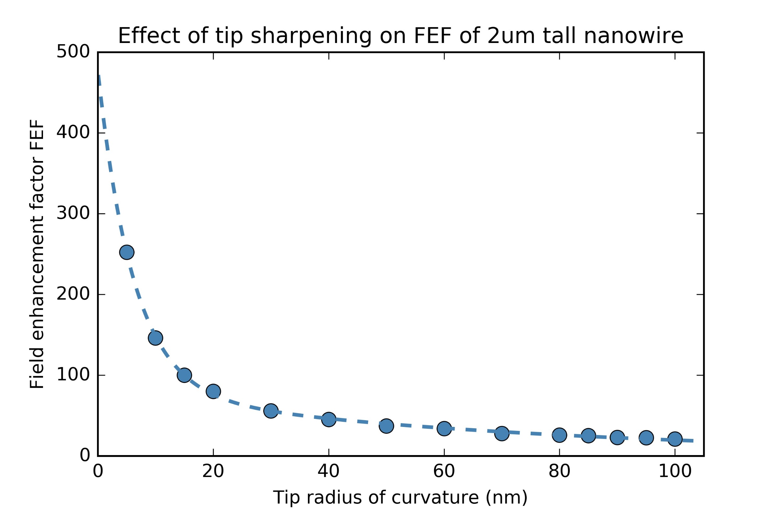
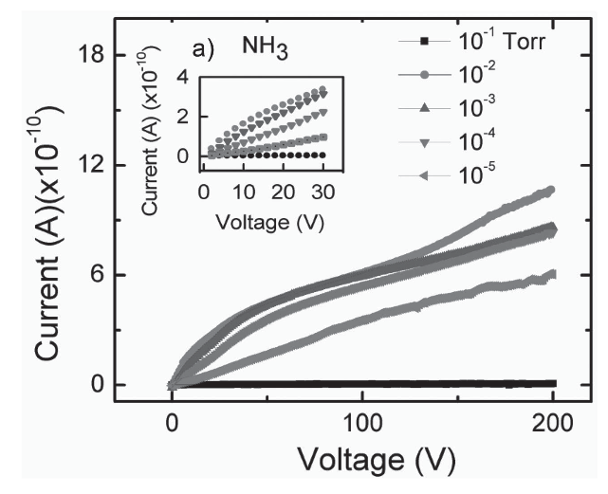
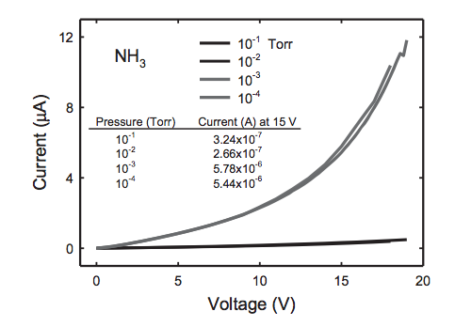


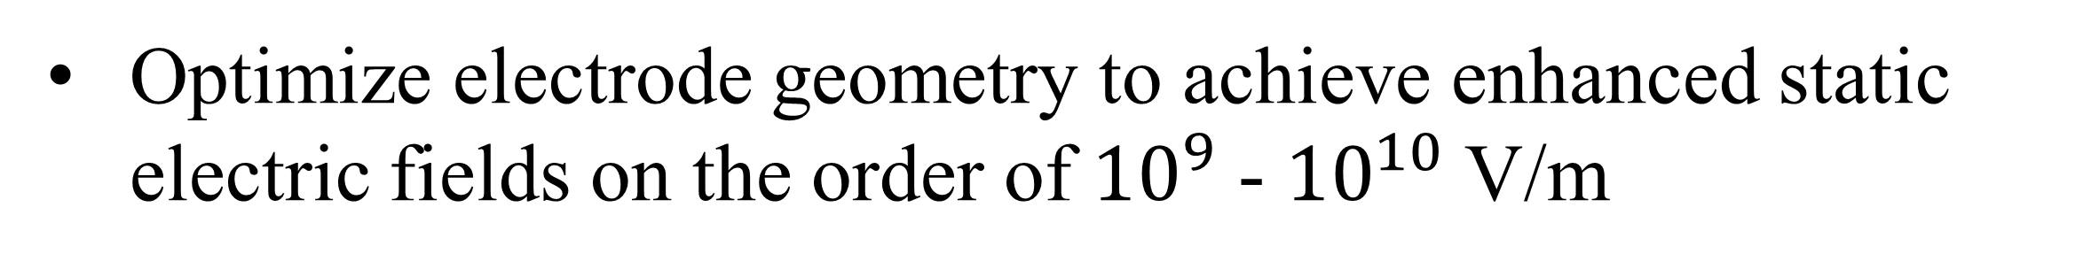


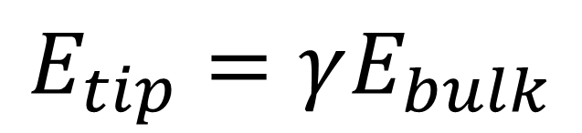

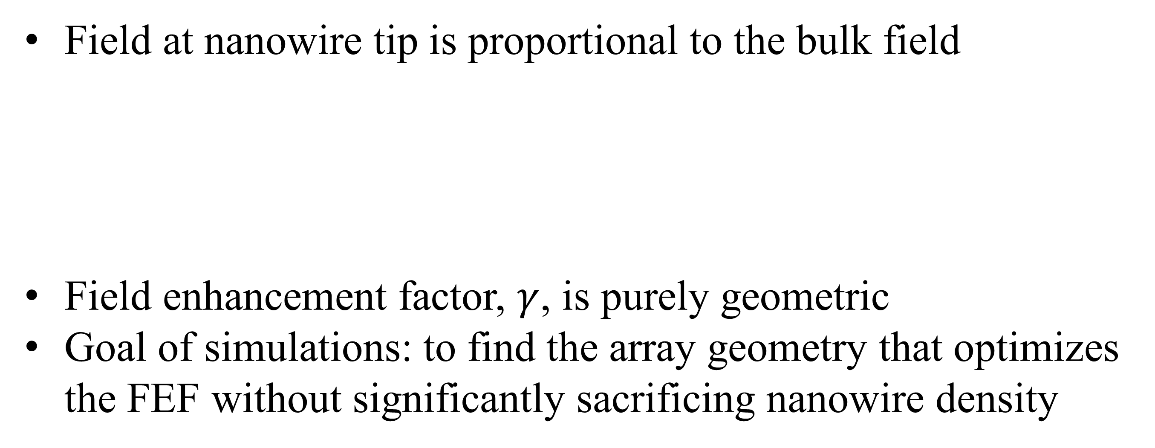



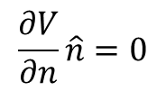


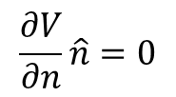




Efficient and scalable field ionization of neutral atoms by an orderly array of gold-doped silicon nanowires
Igal Bucay, Ahmed Helal, Alex Leviyev, David Dunsky, Akhila Mallavarapu, SV Sreenivasan, Mark Raizen
University of Texas at Austin
Introduction
Simulation results
Experimental setup
Our goal is to develop a method of ionization that is efficient, feasible over a large area, and applicable to all atoms on the periodic table.
Field at nanowire tip is proportional to the bulk field
Field enhancement factor, $γ$, is purely geometric
Goal of simulations: to find the array geometry that optimizes the FEF without significantly sacrificing nanowire density
Vacuum chamber
$$E_{tip}=γE_{bulk}$$
Gas feed-through
Macor spacer
Method | Pros | Cons
Photoionization | Efficient, universal | Limited by laser properties, not scalable
Electron impact ionization | Simple, universal | Low efficiency, non-resonant
Surface ionization | Efficient, scalable, simple | Applicable only to alkalis
Static electric field ionization | Efficient, universal, scalable | Difficult to produce large, static electric fields
$$E_{tip}=γ\frac{V_{0}}{d}$$
Electrodes
Si nanowires
Variable leak valve
$$−+$$
A
$$R_{1}$$
$$To DAQ$$
$$R_{2}$$
Goal and theory
Optimize electrode geometry to achieve enhanced static electric fields on the order of ${10}^{9}$ - ${10}^{10}$ V/m
$$204.2 nm$$
Electron energy diagram in an electric field
Potential (eV)
$$132.4 nm$$
$$1.027 μm$$
Axial distance (Å)
$$210.5 nm$$
Gold-doping for low voltage field ionization^{1,2}
Electric field
Coulomb potential with electric field
Coulomb potential without electric field
Electrostatic simulations
$$V=0$$
$$\frac{∂V}{∂n}\hat{n}=0$$
$$\frac{∂V}{∂n}\hat{n}=0$$
References
$$d$$
H Karaagac, MS Islam. Adv. Funct. Mater. 24 (2014), 2224-223.2
RB Sadeghian, MS Islam. Nat. Mater. 10 (2011), 135-140.
Read, Bowring. Nucl. Instr. Meth. Phys. A. 519 (2004) 305-314.
KS Selinidis, CB Brooks, et. al. “Progress in mask replication using jet and flash imprint lithography” 2011
Z Ye, CB Brooks, et. al. “High density patterned media fabrication using jet and flash imprint lithography” 2011.
$$V=V_{0}$$
$$−\frac{s}{2}$$
$$\frac{s}{2}$$

